Slide 1
Data Analysis of Top Music Genres
By: Ruth Holliday, Austin Little, Kimberly Gordon, Nathalie Longstreet, & Gina Kim

Slide 2
Why did we pick this topic?
Why did we pick this topic?
Our Proposal
Our Hypothesis
Music brings people of all culture and ethnicities together. Therefore, we wanted to explore show the trend of the music industry with our acquired analytical skills.
Analyze which genres in the US region took over the top 100 charts over the last 6 years.
GOAL → Create a visual for the trend of the different genres.
The music genre, rap, took over popularity at a faster rate in comparison to other genres and currently holds the highest popularity.

Slide 3
Our Questions:
What’s the most popular music genre in the US today?
For each year, what were the top music genres?
Can tracking the popularity of music genres predict its future?
Has rap reached its height of popularity?
How does the result compare globally? (to global charts)

Slide 4
Our Data Exploration & Clean-up Process:
Steps Taken to Analyze the Data
Discuss the steps you took to analyze the data and answer each question you asked in your proposal
Obtain music api
Extract top songs per year
Create a csv file (song, artist)
Use spotify api to find the genre(s) per song
Append the genre to the csv file.
Create a visualization of the top genres per year.
This is where we had a problem as there were a lot more genres than anticipated.
Compare the trends of each year to each other.
The data was split by year starting from 2012-2017.
Each year was tackled individually.
Explored API’s to obtain genres needed.
Spotify’s API → Spotipy
Wikipedia’s US Top 100 Billboard charts was used to extract CSV files..
Created dataframes that were then used to create the visualizations.
Notes:
Run through a jupyter notebook
Describe the exploration and cleanup process
Discuss insights you had while exploring the data that you didn't anticipate
Discuss any problems that arose after exploring the data, and how you resolved them
Present and discuss interesting figures developed during exploration, ideally with the help of Jupyter Notebook

Slide 5
Billboard Top 100 2012

Slide 6
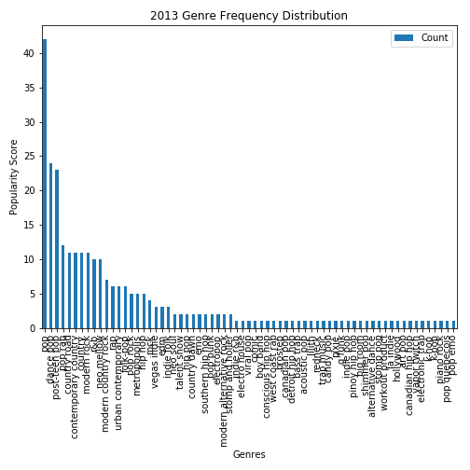
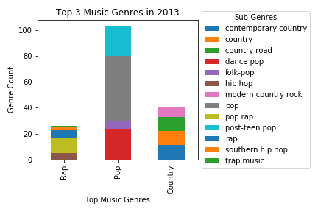
Billboard Top 100 for 2013

Slide 7
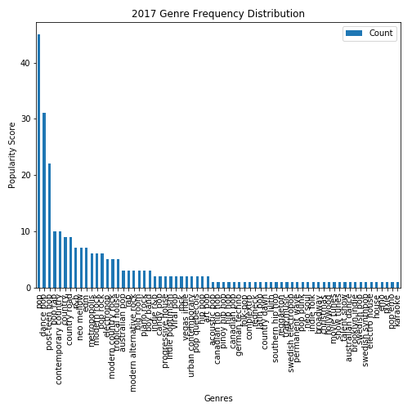
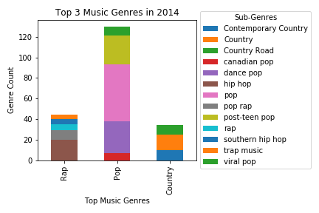
Billboard Top 100 for 2014

Slide 8
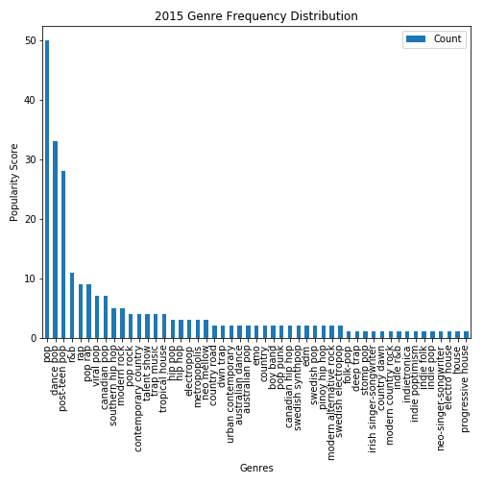
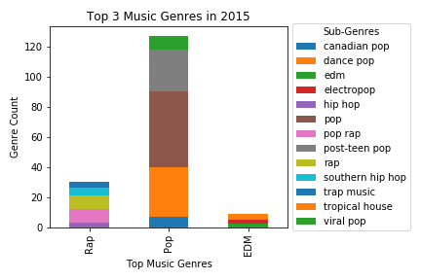
Billboard Top 100 2015

Slide 9
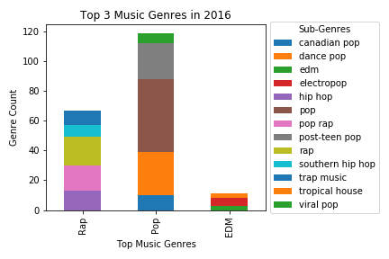
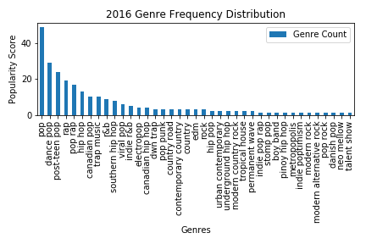
Billboard Top 100 for 2016

Slide 10
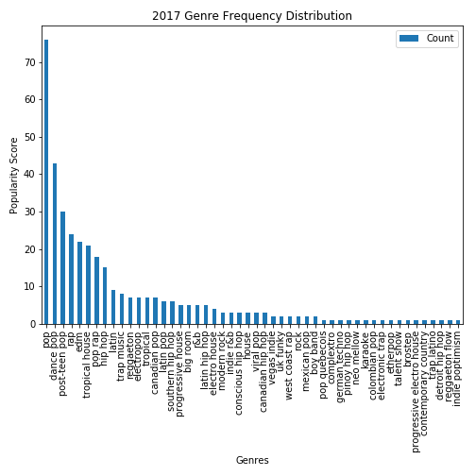
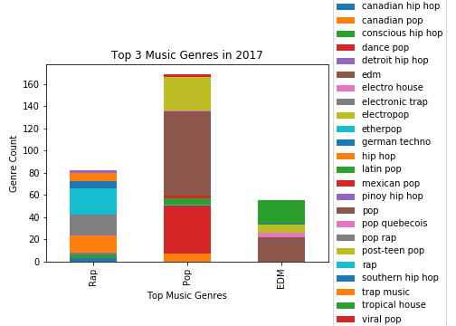
Billboard Top 100 2017

Slide 11
Current Global Music Charts

Slide 12
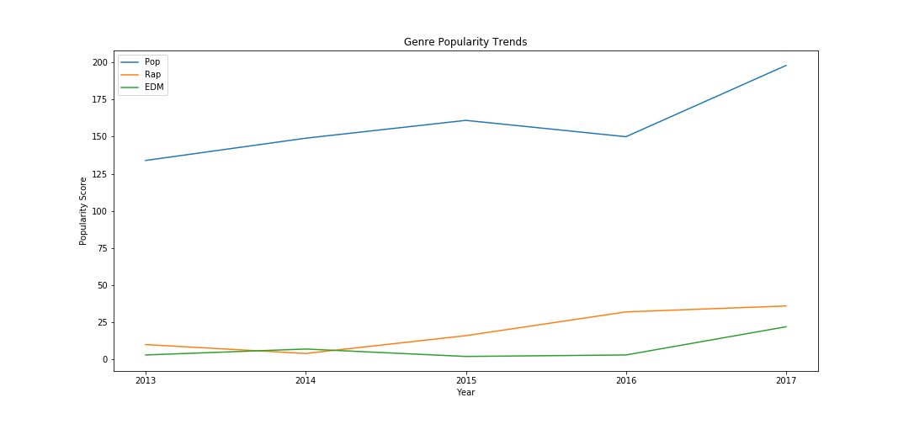
Trend of Music Genres

Slide 13
Some challenges we faced:
Obtaining a good API:
Multiple/no genres:
Years of Music:
We explored the following API’s: MusicxMatch, GraceNote, Spotify, and LastFM. Although spotify’s was most difficult to use, it was the only one up to date with the information we needed.
Many tracks did not have specific genres assigned as they were mostly assigned by artists. Often we would get multiple genres per song after requesting genres from Spotify’s API.
Given that many streaming services are only a few years old, we had to limit the amount of historical music data to the past 6 years. Thus, our results could not be as thorough.
Notes:
What would we do if we had 2 more weeks:
Global trends
Go further back by year.

Slide 14
Our Findings/Discussion:
We discovered the most popular genre in the US today is Pop.
We can infer that Pop has a definite higher rate compared to the other genres. EDM has been on the rise starting 2016 and rap has been steadily increasing since 2014.
For each year, what were the top music genres?
Although rap wasn’t the number one popular genre as we expected, it seems to consistently be in the top 3 main genres.
How does the result compare globally? (to global charts)
Discuss your findings. Did you find what you expected to find? If not, why not? What inferences or general conclusions can you draw from your analysis?

